Slide 1
Meat hygine- practical
Dr. measem hassan ali

Slide 2
Slaughter methods
Electrical stunning This is the most common stunning and slaughter application It works by producing brain dysfunction and unconsciousness with or without subsequent killing by cardiac arrest so that bleed out (exsanguination) is carried out consist of two type.
a. Head-only electrical stunning
Electrical currents, in sufficient quantities, applied on the head produce epilepsy (“grand mal” or seizure-like state), spreading across parts of the brain stimulating other cells. This effect, characterised by rapid and extreme depolarisation of the membrane potential and development of a synchronised electrical response, can be measured and observed on the recorded electroencephalogram (EEG) as small waves with high amplitude in the tonic phase (rigid), and low frequency in the clonic phase (high motor activity in muscles) resulting in depression of electrical activity in pigs, sheep and cattle

Slide 3
b. Head-to-back (cardiac arrest) electrical stunning
This method involves induction of an epileptic state in the brain with concomitant cardiac arrest by electrical currents applied in the chest. The idea behind this method is that animal welfare is maintained because any possible recovery is prevented as stopping the heart kills the animal. Additionally, convulsions caused by epilepsy are greatly reduced making carcasses more manageable hence improving operator safety.

Slide 4
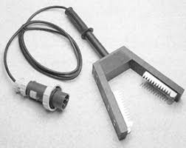
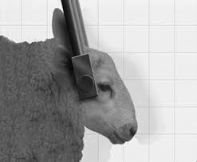
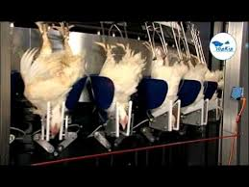
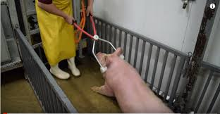

Slide 5
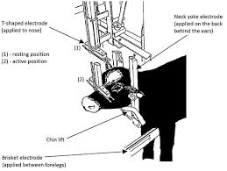

Slide 6
2.Captive bolt (Mechanical) stunning
This method , used correctly, can provide a satisfactory stun instantly meeting the main objective of stunning:
“to render the animal immediately unconscious”. To maintain welfare the “unconsciousness” must be maintained until death without any recovery. Therefore, captive bolt stunning must either be irreversible or possible recovery must be prevented. It is mainly used in cattle, less frequently in sheep.

Slide 7
The following factors determine success of captive bolt stunning
:
• Provision of a suitable gun with the correct strength in optimum working order
• Hitting the right target area (variations between species)
• Bolt velocity (at least 50 m/second) and impact on head
• Tissue damage
• Penetration
• Amount of energy (most important determinant)
• Gun type and condition, choice of cartridge/air pressure Carbon deposits built up inside the barrel must be brushed out.

Slide 8
Penetrating guns fire the bolt into the brain through the cortex, midbrain and brain stem

Slide 9
Non-penetrating guns deliver a blow on the skull damaging the cortex, midbrain and brain stem

Slide 10
3.Other stunning and slaughter methods
Carbon dioxide
Because conventional electrical stunning methods can have adverse effects on carcass and meat quality gas stunning methods have been introduced and used in the last 3 decades. Carbon dioxide, the principle agent, and inert gases such as argon and nitrogen can be used and pigs and poultry are the chosen species. Although cattle and sheep are not suitable for gas stunning due to size and presence of wool some recent trials in sheep have been carried in Spain successfully.

Slide 11
Water jet and air pressure
High water jets developed for cutting and drilling in solid materials are available for use as stunners. Experiments to explore the suitability of water jets for stunning and killing purposes were conducted under laboratory conditions using post mortem materials (e.g. pig heads) and also on live slaughter pigs. Immediate unconsciousness as determined by EEG, was initiated by a rapid penetration of the skin and skull. In these studies destruction of the brain occurred within 0.2 to 0.4 s.

Slide 12
Other slaughter method
Neck dislocation and neck cutting
Heating
Cooling down
Fragmentation
Magnetic stimulation

Slide 13
4.Halal slaughter
slaughter is carried out by severing the neck to achieve instant and copious exsanguination using a sharp knife. The usual type of incision is transverse severance of the vessels in the retrograde fashion following an initial stab incision in the neck.
Muslims believe that they are required to ensure rapid and maximum blood loss and that this is crucially important during and after Halal slaughter, because consumption of blood is forbidden. Effective exsanguination however, has been a source of concern in that in some cases occlusions can impede bleed out rate and delay loss of consciousness .Another claim was that stunning methods could impede blood loss during Halal slaughter.

Slide 14
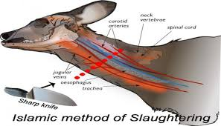

Slide 15
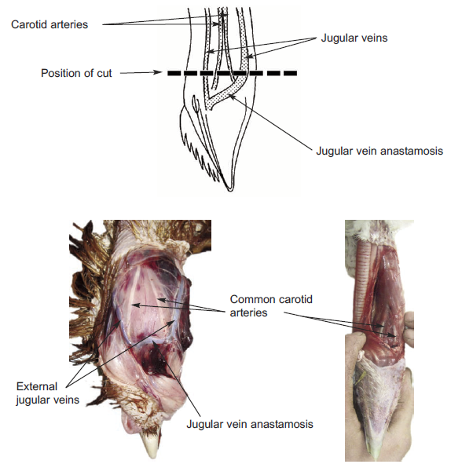

Slide 16
Effects of religious slaughter on quality
Carcass and meat quality
The main potential effects of stunning and slaughter on carcass and meat quality . These are carcass defects such as haemorrhages, bruising, broken bones and more importantly rate and total bleed out, particularly in relation to religious slaughter without stunning. haemorrhages can be related to inappropriate pre slaughter handling, electrical stunning using high voltages with currents and sometimes due to possible nutritional or unknown factors such as blood splash in sheep. These defects and resultant downgrading can occur during slaughter with and without stunning. If electrical stunning is used before religious slaughter as long as sticking is done early enough, rising blood pressure may not be a problem

Slide 17
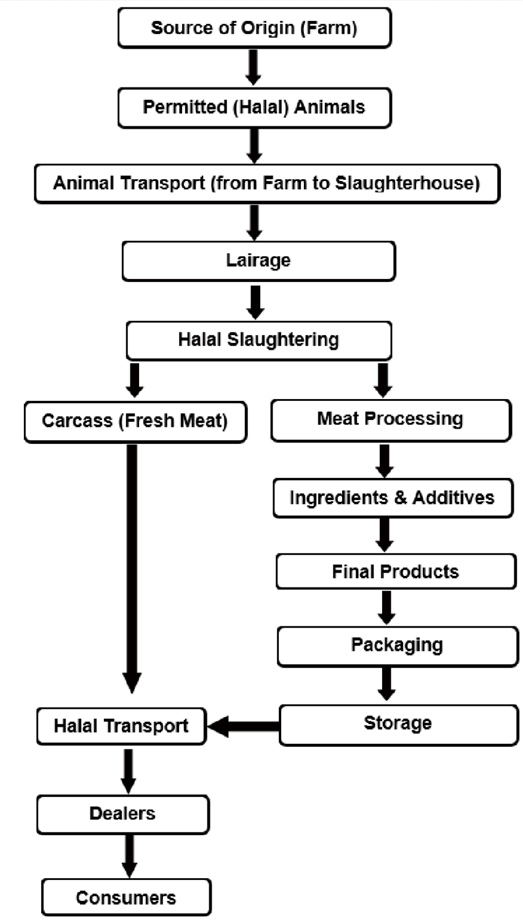

Slide 18
effects of electrical stunning and no stunning on meat quality
in lambs. They are not differences in colour muscle ultimate pH (pHu), chilling losses and carcass weights after 45 min and 24hrs .
The only effect was petechial haemorrhages in hearts caused by electrical stunning with 250 volts for 3 seconds. No carcasses with petechial haemorrhages, ecchymosis, haematomas or broken bones were found.

Slide 19
Blood loss and retention
It is of utmost importance to expel as much blood as possible to meet religious requirements of Halal and Shechita slaughter. In addition to consumption of blood being forbidden, there are two beneficial reasons put forward,
1- harmful blood constituents would be excluded.
2- keeping quality of meat would improve.
3- The basis for better keeping of meat was that blood would provide a good medium for bacteria to grow.
4- Another consideration is that if blood is left in vessels, after cutting, it could produce an unsightly appearance.
4- However, it has been shown that minced meat mixed with blood and inoculated with bacteria showed no more growth of included bacteria than meat that had no added blood .
5- Nevertheless, although it is impossible to rid a carcass of its blood completely as there will be some retention of blood, efforts need to be made.

Slide 20
6- the stunning would adversely affect bleed out rate and total loss and that neck cutting without slaughter improved blood loss.
7- measured blood haemoglobin content in different muscles as an indicator of bleed out quality.
8- blood parameters, colour and pH were measured in different species slaughtered by Shechita or Halal or conventional methods showing no difference.
9-sticking and blood loss could still be better after Shechita( halal saulghter) because of the very sharp knife used and efficacy of cut.

Slide 21
thank you

